Slide 1
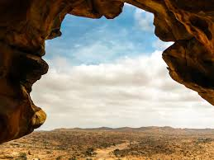

THE IMPACT OF TAKAFUL ON THE ETHIOPIAN ECONOMY
ASSEGED G/MEDHIN
C.E.O
AT(@t) INSUARNCE BROKERAGE & FINANCIAL CONSULTANT
MARCH 5 , 2024
SOAMILAND

Slide 2
Somaliland: The Horn of Africa’s Breakaway State

Slide 3
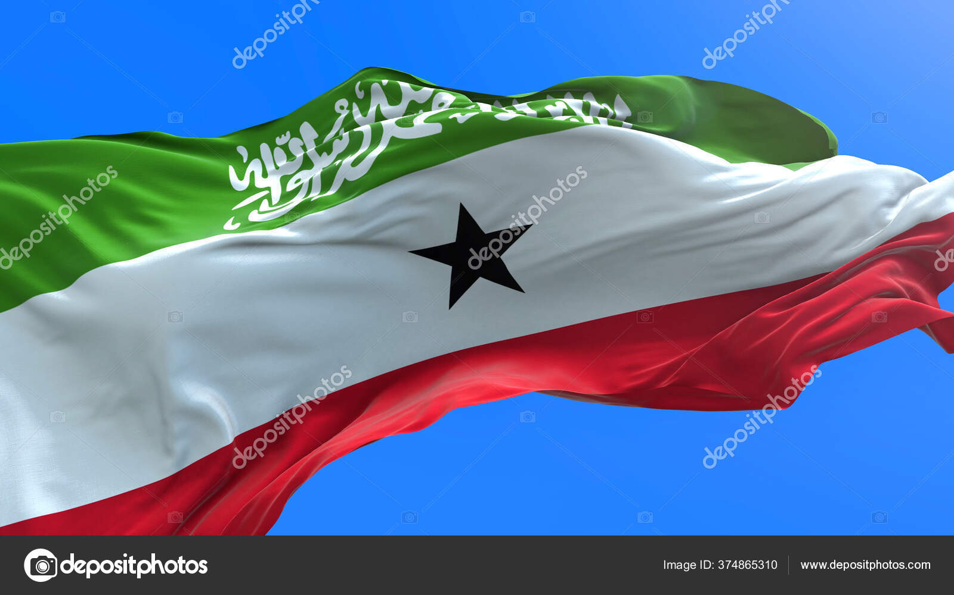

Slide 4
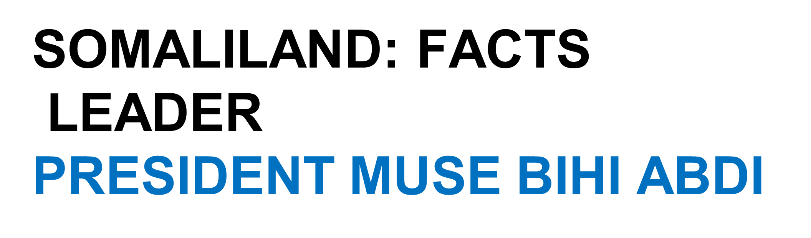
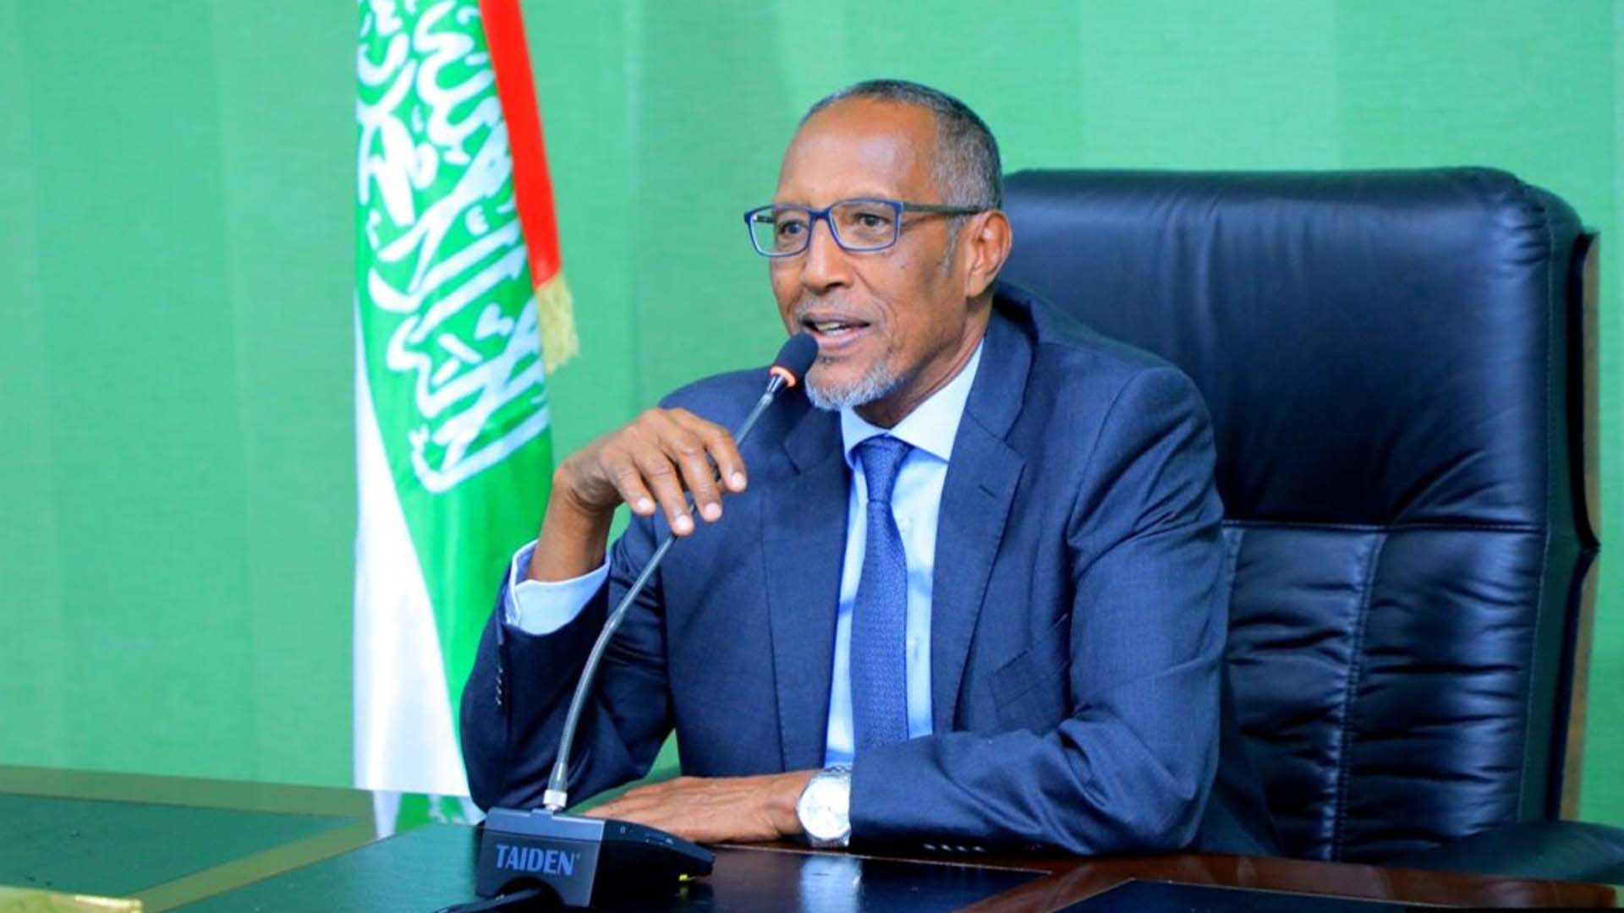

Slide 5
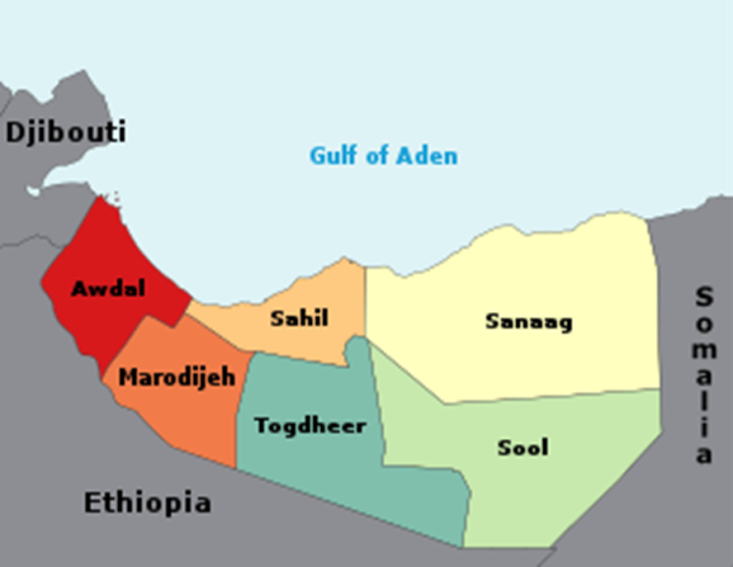
Somali land is constituted out of five large family clans:
The Dir,
The Isaaq,
The Darood,
The Hawiye and
The Rahanweyn

Slide 6
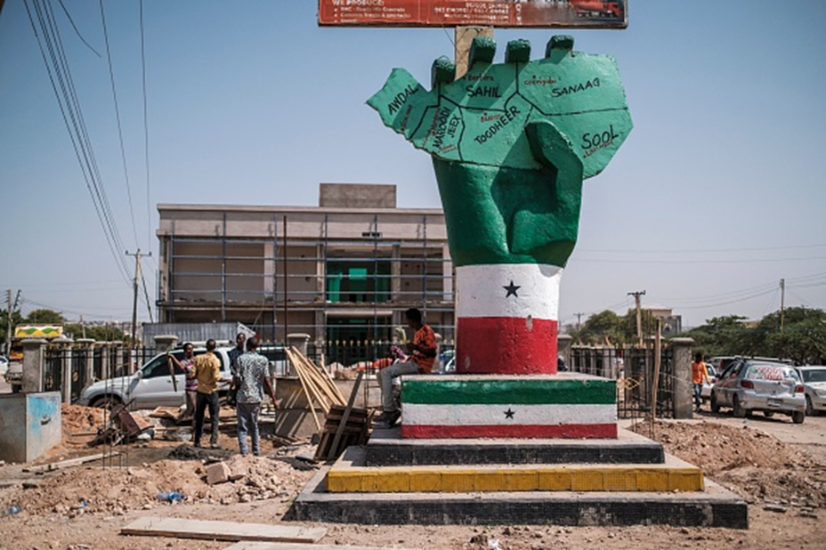
Somali land is constituted out of Six parts :
Sannage
Sool
Togdheer
Sahil
Marodijeh
Awdal

Slide 7
SOMALILAND: FACTS
LEADER
PRESIDENT MUSE BIHI ABDI
Capital
Hargeisa
Area:177,000sq km
Population: 5.7 million
Languages: Somali, Arabic, English
Life expectancy: 50 years
Major export : The Economy of Somaliland largely relies on primary production and agriculture, where livestock is the main export of the country, which it ships to neighboring Djibouti and Ethiopia, as well as to Gulf states, such as UAE, Saudi Arabia and Oman.
GDP : 3.1% (2023)
Currency : Somaliland shilling

Slide 8
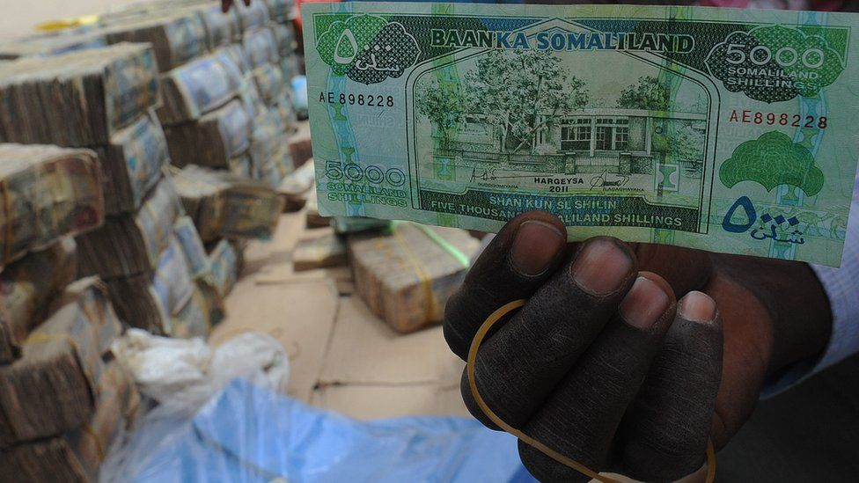
TIMELINE

Slide 9
7th Century - Islam starts to make inroads into the area of modern-day Somaliland.
14th Century - The area's Islamic sultanates come under the suzerainty of the Christian Ethiopian Empire.
1527 - Sultanate of Adal revolts against Ethiopian rule and subsequently conquers much of Ethiopia, before being defeated with the help of the Portuguese in 1543.
1888 - Britain establishes the protectorate of British Somaliland though treaties with the local sultanates.
1899 - Islamic cleric Mohammed Abdullah rises against British rule, going on to establish the Dervish State, which survives until it is destroyed by British forces in 1920.
1960 - British Somaliland and Italian Somaliland become independent and merge to form the Somali Republic.
1991 - The former British Somaliland declares unilateral independence as Somaliland following the ousting of Somali President Mohamed Siad Barre, which plunges the rest of Somalia into anarchy.
2001 - More than 97% of the population votes to endorse the constitution adopted in 1997, in a referendum aimed at affirming Somaliland's self-declared independence.
2016 - Somaliland celebrates 25 years of self-declared independence, but remains unrecognized.
2024 - Ethiopia and Somaliland sign a memorandum of understanding for landlocked Ethiopia to use one of Somaliland's ports. Somalia describes the agreement as an act of "aggression".

Slide 10
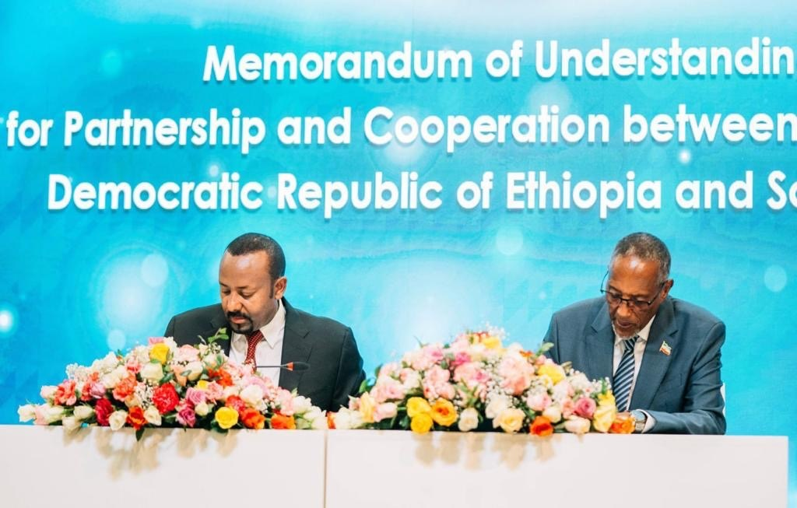
2024 -
Ethiopia and Somaliland sign a memorandum of understanding for landlocked Ethiopia to use one of Somaliland's ports. Somalia describes the agreement as an act of "aggression".
1ST JANUARY 2024
ETHIOPIA ADDIS ABABA

Slide 11
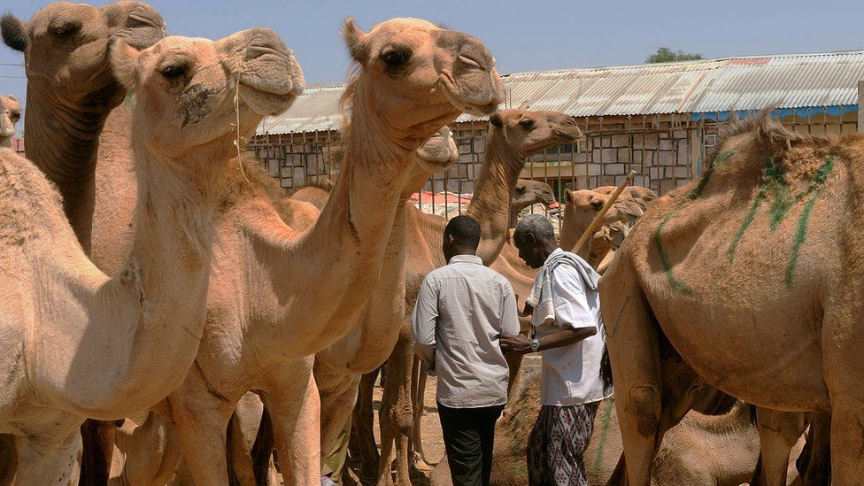
Image caption,
Livestock exports are an important source of revenue

Slide 12
THE IMPACT OF TAKAFUL ON THE ETHIOPIAN ECONOMY
ASSEGED G/MEDHIN
C.E.O
AT(@t) INSUARNCE BROKERAGE & FINANCIAL CONSULTANT
MARCH 5 , 2024
SOAMILAND

Slide 13
PRESENTATION HEAD LINE
I.PROFILE : Country & Financial Institution.
II. Ethiopian Economy
III. Ethiopian Financial Sector
A.BANKING SECTOR
Conventional
Interest Free Banking Service
Interest Free Micro Finance
B. INSURANCE SECTOR
Conventional
Interest Free Insurance service –TAKAFUL
Interest Free Insurance service –MICRO –TAKAFUL
IV. Lesson Learned
V. Recommendation
VI. Contact

Slide 14
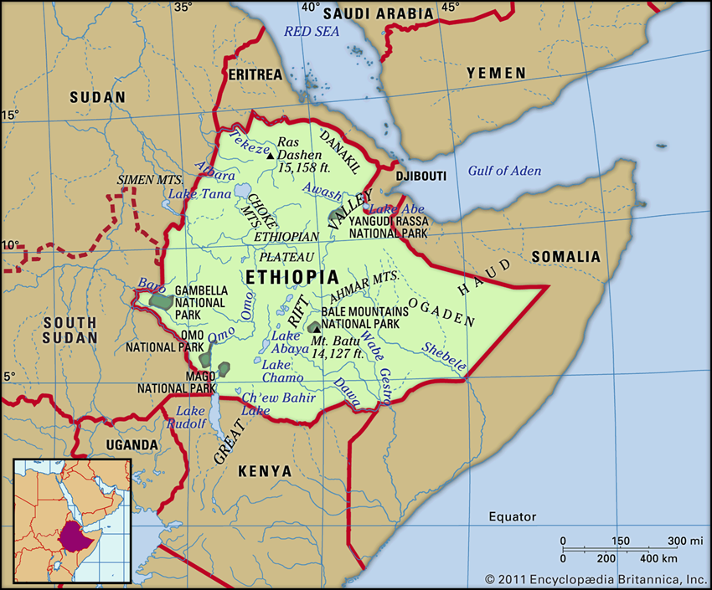

Slide 15
World Bank Ranking
Currency
Year | 2023
Total Population | 120 Million
GDP (Current US$) | 312 Billion
GDP Growth (Annual %) | 6.3
GDP- Per Capita (PPP) (USD) | 2812.50
Imports (As % of GDP) | 6%
Exports (As % of GDP) | 1%
Inflation Consumer Price Annual % | 40%
Unemployment Rate | 19.1%
Structure of the Economy (% of GDP)
Agriculture | 37.54%
Industry | 22.72%
Services | 36.64%

Slide 16
I.PROFILE : Country & Financial Institution.
PROFILE
A1. COUNTRY PROFILE.
Population : 120Million UN 2023, 85% RULAR
Area : 1.13.mln.sq.Kms.
Life expectance: 56years(male ) ,59 years female
GNP per capita: US$1000(WB 2023)
Maine Export : coffee , Hides, oil seeds, Flowers, kchat , e.t.c
Main food crops : wheat ,Barely ,Maize,Teff.
The most dominant religion is orthodox and Muslim . It is beloved almost half of the population is Muslim .

Slide 18
Among other factors, growth was led by capital accumulation, in particular through public infrastructure investments. Ethiopia’s real gross domestic product (GDP) growth slowed down from FY2019/20 to FY2021/22 due to multiple shocks including COVID-19, with growth in industry and services easing to single digits. However, agriculture, where over 70% of the population is employed, was not significantly affected by the COVID-19 pandemic, and its contribution to growth slightly improved compared to previous years.
The consistently high economic growth over the last decade resulted in positive trends in poverty reduction in both urban and rural areas. The share of the population living below the national poverty line decreased from 30% in 2011 to 24% in 2016 and human development indicators improved as well. However, gains are modest when compared to other countries that saw fast growth, and inequality has increased in recent years. Furthermore, conflicts in various parts of Ethiopia risk undermining the economic and social development progress the country has achieved.

Slide 19
II. Ethiopia Economic
With about 123 million people (2022), Ethiopia is the second most populous nation in Africa after Nigeria, and one of the fastest-growing economies in the region, with an estimated 6.4% growth in FY2021/22. However, it also remains one of the poorest, with a per capita gross national income of $1,020. Ethiopia aims to reach lower-middle-income status by 2025.
Ethiopia’s strong growth rate builds on a longer-term record of growth over the past 15 years where the country’s economy grew at an average of nearly 10% per year, one of the highest rates in the world.

Slide 20
The government has launched a 10-Year Development Plan, based on its 2019 Home-Grown Economic Reform Agenda, which runs from 2020/21 to 2029/30. The plan aims to sustain the high growth achieved under the Growth and Transformation Plans of the previous decade while facilitating the shift towards a more private-sector-driven economy. It also aims to foster efficiency and introduce competition in key growth-enabling sectors (energy, logistics, and telecom), improve the business climate, and address macroeconomic imbalances.

Slide 21
Development Challenges
Ethiopia seeks to chart a development path that is sustainable and inclusive in order to accelerate poverty reduction and boost shared prosperity. Significant progress in job creation, as well as improved governance, will be needed to ensure that growth is equitable across society. Achieving these objectives will require addressing key challenges including the following:

Slide 22
Addressing macroeconomic distortions that constrain private sector development, structural transformation, and generation of jobs.
Reducing the incidence of conflict that has been having a substantial impact on lives, livelihoods, and infrastructure. The cessation of hostilities in the North in November 2022 is an important step in this direction.
Overcoming the effects of the COVID-19 pandemic. Like the rest of the world, Ethiopia has been experiencing the unprecedented social and economic impact of the pandemic. While exports and foreign direct investment rebounded in 2020/21 and jobs have been recovering, some lasting scars are likely to remain. Urban employment levels have not recovered fully, some households and firms continue to report income losses, and poverty is estimated to have increased.

Slide 23
Addressing food insecurity, which is growing due to adverse weather events, locust invasion, conflict, and global conditions leading to high inflation of food prices. Frequent severe weather events alongside long-term impacts of climate change undermine agriculture and pastoral livelihoods as well as food security. The 2022 drought is the worst in forty years, severely affecting millions in the southern and eastern parts of the country. Overall, more than 20 million persons are facing severe food insecurity in 2023.
Improving human capital. Ethiopia’s Human Capital Index is at a low 0.38 (2020) which means that a child born in Ethiopia today will be 38% as productive when s/he grows up as s/he could be if s/he enjoyed complete education and full health. This is lower than the average for the Sub-Saharan Africa region but slightly higher than the average for low-income countries. Learning poverty stands at 90% and 37% of children under 5 years of age are stunted.
Generating good jobs. The country’s growing workforce (with roughly 2 million persons reaching working age per year) puts pressure on the absorption capacity of the labor market, necessitates improving current jobs, while creating sufficient new jobs.

Slide 24
III. Ethiopian Financial Sector
GNP per capita: US$1000(WB 2023)
Maine Export : coffee , Hides, oil seeds, Flowers, kchat , e.t.c
Main food crops : wheat ,Barely , Maize, Teff.
Regulatory Body National Bank of Ethiopia (NBE)
No. of Commercial Banks : 31( 2 gov’t 29 private)
No. of Commercial Banks : 18( 1 gov’t 17 private)
No. of Micro Finance : 47( All private )
No. of Insurance companies : 18( 1 gov’t, 17private)
No. of Interest Free Banks-window : 25( 1 gov’t , 24 private )
No. of Interest Free Banks-full flagged 3( All private )
No. of Interest Free insurer-Wakala Model : 5 (All private)
No. of Micro Insurers 3( 1 gov’t, 2private)
There is no Micro Takaful to date ( March 2024)
There are 4 Islamic MIF(All private)

Slide 25
GOVERNANCE
the country’s financial sector is governed by central bank
it is the supreme power hose of any regulatory issues .
Ethiopia has passed different form of government
1. Modern imperial government where you found
foreign investors in financial sector both in banking and
insurance service
2. The military Government which command economy .
3. The EPRDF WHICH IS THE MARKET ECONOMY but the
sector is blocked for foreigners only privatization
4. The liberal Economy ( The banking sector is opened for
foreign investors .

Slide 26
RECENT CHANGES
Introduction of ALTERNATIVE INSUARNCE –TAKAFUL DIRECTIVE following the growth in interest free banking .
The directive SIB/1/2020 permitted all insurer as well as reinsurer to do alternative insurance TAKAFUL .
THE FIRST ETHIOPIAN ALTERNATIVE INSUARNCE PROVIDER IS GLOBAL INSUARNCE S.C with the help of ALHUDA CIBE .
BUSINESS PROCLAMATION NUMBER 522/2008 AMENDED BY SSB/51/2011
n May 2019, Abiy Ahmed, the Ethiopian Prime Minister, expressed his approval in favor of the establishment of financial institutions entirely dedicated to Islamic finance. In June, the same year, the Central Bank issued a directive authorizing the creation of Islamic banks.
DIRECTIVE NO. SBB/72/2019 ISSUED FOR FULLFLAGED ISLAMIC BANING SERVICE IN ETHIOPIA.
ON 3RD OF OCTOBER 2022 , Ministry of council approved opening up of financial sector (banking service ) to foreign investors
NBE official speaking on the basis of anonymity told the publication that this policy allows foreign investors to buy up to a 40% equity stake in existing Ethiopian banks, with a maximum of 5% allowed for individual foreign investors, 5% for non-bank investors and 30% for foreign banks.

Slide 27
3.1. ETHIOPIAN FINANCIAL SECTOR IN DETAIL
Banks, insurance companies and micro- finance institutions are the major financial institutions operating in Ethiopia .
The sector remained robust and played a significant role in facilitating socio-economic growth through its financial intermediation function. Accordingly, in 2021/22, new banks, including interest free banking entered in to the banking industry thereby raising the number of overall bank branches to 8,944 from 7,344 a year ago.
They also accelerated their deposit mobilization (25.7 percent), loan collection (48.6 percent) and loan disbursement (29.9 percent).
Their non-performing loan ratio was within the required ceiling of 5 percent and all other financial indicators revealed the safety and soundness of the sector. Likewise, insurance companies, microfinance institutions and capital goods finance companies have scaled up their outreach by expanding their network and diversifying their products.
Their soundness was also duly ensured. All in all, financial intermediation access to finance and financial inclusion have steadily expanding.

Slide 28
3.1.1 BANK INDUSTRY
The number of banks in Ethiopia has reached 31, of which, 29 were private and 2 state owned. These banks opened 314 new bank branches during the fourth quarter 2022/23 alone, thereby raising the number of bank branches to 11,281. As a result, population to bank branch ratio stood at 9,514.3³. State own banks accounted for 20 percent of the total bank branches while private banks took 80 percent share. Of the total bank branches, 32.6 percent were located in Addis Ababa. State owned banks accounted for 36.2 percent and private banks 63.8 percent of the total capital. As a result, population to bank branch ratio reached 12 thousand people per branch. About32.7 percent of the total bank branches were located in Addis Ababa.At the same time, total capital of the banking industry showed a 31.7 percent annual growth to reach Birr 199 billion .

Slide 30
3.1.2 MICRO FINANCE
At the end of review quarter , the number of Micro finance institutes (MFIs) was 47. Their savings, creadits and total asset increased by 28.8%, 23.7% and 18% on annual bases respectively. Similarily , their capital showed a 20.5% annual decrease to reach to birr 9.6 Billion . All thee indicators siginify the relative importance or Micro –Finance institut in providing access to financial service to low income and small –sace enterprises both in rural and urban areas as showen in ( table 4.7)

Slide 31
Particulars | 2021/22 | 2022/23 |  | % Change
 | QIV | Q III | QIV
 | A | B | C | D=C/A | E=C/B
Total Capital | 12,079,853.6 | 13,504,257.2 | 9,597,910.0 | -20.5 | -28.9
Saving | 21,670,882.0 | 24,000,707.5 | 27,903,518.7 | 28.8 | 16.3
Credit | 31,654,784.3 | 36,265,195.4 | 39,171,342.4 | 23.7 | 8.0
Total Assets | 46,129,535.9 | 52,455,915.9 | 54,445,035.9 | 18.0 | 3.8

Slide 32
Interest Free Banking ( IFB) industry status
As at December 31,2022
S/N | Bank | IFB Deposit |  | IFB Financing
 |  | Customer Base | Total Balance | Total Balance
1 | Abay Bank | 232,961.00 | 2,100,000,000.93 | 1,423,269,395.99
2 | Abyssiniya | 1,312,269.00 | 16,272,564,043.44 | 2,933,821,133.95
3 | Awash | 1,594,055.00 | 13,411,562,370.00 | 8,370,836,298.01
4 | Amhara | 23,480.00 | 278,797,858.13 | No Financing
5 | Buna | 184,507.00 | 1,211,477,766.12 | 44,401,565.07
6 | CBE | 5,518,354.00 | 18,849,660,000.00 | 13,839,519,596.89
7 | CBO | 2,674,370.00 | 7,150,405,304.15 | 16,949,017,954.37
8 | Dashin | 546,635.00 | 122,336,170.04 | 5,070,750,627.40

Slide 33
9 | Debub Global | 26,119.00 | 2,900,000,000.00 | No Financing
10 | Hibret | 160,000.00 | 2,367,432,538.00 | 1,900,000,000.00
11 | Hijira | 222,414.00 | 4,473,000,002.00 | 1,257,057,954.37
12 | NIB | 378,830.00 | 7,666,000,002.00 | 1,240,000,000.00
13 | Oromia | 946,000.00 | 342,264,819.00 | 6,050,000,000.00
14 | Sinqee | 132,687.00 | 1,800,000,002.00 | 31,295,061.00
15 | Wegagen | 150,000.00 | 1,800,000,003.00 | 304,000,000.00
16 | Zaman | 186,907.00 | 3,039,923,162.36 | 1,755,622,046.22
 | Total | 14,289,588.00 | 83,785,424,041.17 | 61,169,591,633.27

Slide 34
3.1.3 Interest Free Micro Finance
The establishment initiation of Islamic financial institutions in Ethiopia is not only in the banking sector. However, interest-free microfinance institutions are operating in Ethiopia without adequate legal firework.
Table 6.shos that microfinance institutions are providing sharia-compliant microfinance services in the Muslim dominated areas of Ethiopia.

Slide 35
No. | Name Islamic MFI | Establishment Year
1 | Harar Microfinance Institution (HMFI) | 2014
2 | Dire Micro Finance Institution (DMI) | 2013
3 | Somali Microfinance Institution (SMFI) | 2012
4 | Rays Microfinance Institution (RMFI) | 2014

Slide 36
3.2 INSURANCE
3.2.1 conventional Insurance
Insurance companies increased their total capital by 14.7 percent to Birr 11.1 billion whose share of private insurance companies was 73.6 percent and that of public insurance company was 26.4 percent (Table3 ). For the last several decade the contribution of insurance sector interterms of economic development is insignificant. it is stil less than 1 % of the GDP and penetration ration is also less than 0.10%.. Number of insurance company remains stagnant than expected increase since transformation and the size of capital though is beyond

Slide 37
3.2.1.1 Gross Written Premium
The insurance industry has come a long way from performance at the beginning of domestic investors setting up insurance companies at the start of 1994/15 fiscal year. At the end of 1993/94 fiscal year, the total gross written premium (GWP) of the industry was Birr 254 million out of which the non-life insurance business accounted for the 246 million Birr.
After a quarter of a century of business in which the number of private insurers grew from none to seventeen and the industry totaling eighteen companies (including the state owned EIC), the gross nonlife insurance premium reached at Birr 15.3 billion for the fiscal year ending as at June 30th 2022.
The insurance sector has been progressively growing over the years having average growth rate of 5.8% between the years 1994/95 to 1999/2000, 17.1% in the 2000s (2001-2010) and 19.2% from the 2010/11 fiscal year until the end of the 2019/20 fiscal years. In spite of the growing base in premium income, political instability and Covid-19 pandemic; the industry managed to register a staggering average growth rate of 17.5% in total and 16.66% in nonlife insurance business over the past five fiscal years. The following table illustrates the growth rate in the past five years by class of business.

Slide 38
No | Class of Business | Fiscal Years
 |  | 216/17 | 2017/18 | 2018/19 | 2019/20 | 2020/21 | 2021/22
1 | Accident | 260,469.00 | 294,117.00 | 323,751.00 | 352,776.00 | 435,654.00 | 536,250.00
2 | Aviation | 458,788.00 | 574,376.00 | 771,169.00 | 1,958,699.00 | 2,651,904.00 | 2,266,706.00
3 | Fire | 487,361.00 | 580,813.00 | 674,959.00 | 773,631.00 | 954,120.00 | 1,086,533.00
4 | Engineering | 507,691.00 | 594,291.00 | 570,587.00 | 707,300.00 | 742,437.00 | 1,155,500.00
5 | Employee Liability | 160,567.00 | 180,100.00 | 190,426.00 | 176,022.00 | 178,542.00 | 181,451.00
6 | Liability | 221,856.00 | 260,246.00 | 264,046.00 | 285,310.00 | 325,962.00 | 357,009.00
7 | Marine | 532,261.00 | 472,560.00 | 556,296.00 | 649,323.00 | 655,553.00 | 968,988.00
8 | Motor | 3,982,203.00 | 4,346,317.00 | 4,565,616.00 | 4,918,654.00 | 5,567,981.00 | 6,856,136.00
Source (Own research) .

Slide 39
9 | Pecuniary | 429,814.00 | 453,614.00 | 456,850.00 | 508,543.00 | 773,215.00 | 1,014,489.00
10 | Others | 92,468.00 | 163,064.00 | 208,752.00 | 248,997.00 | 629,840.00 | 890,554.00
Non-Life Total GWP |  | 7,133,478.00 | 7,919,498.00 | 8,582,452.00 | 10,579,255.00 | 12,915,208.00 | 15,313,616.00
11 | Life Business | 360,092.00 | 460,780.00 | 514,310.00 | 578,957.00 | 958,751.00 | 1,351,790.00
Industry GWP |  | 7,493,570.00 | 8,380,278.00 | 9,096,762.00 | 958,751.00 | 13,873,959.00 | 16,665,406.00
Growth Rate (Non-life ) |  |  | 11.02 | 8.37 | 23.27 | 22.08 | 18.57
Average five years Growth Rate (Non-life) 16.66
Growth Rate (life ) |  |  | 27.96 | 11.62 | 12.57 | 65.6 | 40.99
Average Five years growth rate( life ) 31.75
Growth Rate (Industry) |  |  | 11.83 | 8.55 | 22.66 | 24.34 | 20.12
Average Five years Growth Rate ( Industry) 17.50
Source (Own research) .

Slide 40
4. Takaful Insurance
  Islam teaches us not only to have ldependence on Allah but also emphasizes on self protection against risks and threats.
TakafulisanIslamicalternativetotheconventionalInsurance.Thewords ‘Takaful’ has been derived from the Arabic verb ‘Kafala’ which is also referred to as ‘Kafalat’ in Urdu language, its means to guarantee, to help, to take care of one another’s needs.
The Takaful system has been structured keeping in view the Islamic system of Dait (Blood Money) which is the philosophy behind mutual assistance/Kafalat. Before going into further details about Takaful, we shall have a look at the conventional insurance system and the factors that led to it being considered Haram or illegal in the society.
If the importance of insurance is observed in detailed, the following aspects emerge:
To bear the risk/threat
To protect others
To share the loss
Keeping in view the basic element so insurance, it is evident that now here in Islam the above-mentioned aspects are prohibited and that there is no reason to be considered haram or illegal since Islam itself encourages to help others.

Slide 41
4. Benefit of Takaful in the economy
Strategic Issues
Learning and growth perspective
Develop Human Capital with the required competences, succession plans and performance management system for the proposed tactful
  Equipping the company with highly competent employees through well-developed competence framework in Islamic finance ;
  Continuous training and capacity building for all employees following the growth of the business.
  develop and implement a well-designed performance-based incentive management system; and
  well-founded career development and succession planning programs to be in place
Create organizational culture that meets values, assumptions and artifacts set by the organization that create a sense of order, continuity, and commitments to meet the strategic objective of tactful insurance . and for this reason :
  Everyone is aware of the alternative insurance /takaful insurance
  Regular performance evaluation to create best team and reward each team for best performance
  Creating good perception about the alternative insurance through different mechanisms as set in the strategy.
  Develop ICT program to bring about efficiency and effectiveness in all organizational processes and service centers.
  IT investment is critical for financial service company, such as Takaful Insurance insurtech for Takaful business.
  Properly identified software for enterprise resource planning of that takaful insurance

Slide 42
4. Benefit of Takaful in the economy
Internal process perspective
Develop a system that brings about efficiency and effectiveness of all processes
  There will be standard quality, cycle time and cost measurement for every underwriting process
  There will be standard quality, cycle time and cost measurement for every claims management process
  There will be standard quality, cycle time and cost measurement for every marketing management process
  Every process will have its own qualitative and quantitative measures.
  There will be clearly identified risk management system with a clearly set risk appetite approved by sharia advisory board / Board of Directors . the risk management process and the system employed ultimately provide an overview of all processes in the organization so the decision will be made based on adequate information .
  Reputation/ image building through well-articulated and designed media platform for all personal sales, advertising, sales promotion and other Halal promotional systems. There will be a thorough and frequent checking of effectiveness of such media.
Financial perspectives

Slide 43
4. Takaful Insurance
. Customer Perspective
Establish customer relationship management: -
  Ensuring a very Low level of customer complaint and continuous review of Company’s complaint management system and a customer satisfaction designs in all systems
  Ensuring that there will be high persistent rate of insurance policies and renewal of at least 85% to 90% of existing business
  Increasing annual new business by 30-35% to be attracted every year
  A customer and employees satisfaction survey to be conducted at least every three years to assess Company’s level of customer service and identify areas for improvement
  Ensuring presence in service centres in terms of service hours, branch network, innovative technology and door step services/ personal service for selected customers
  Increase market leadership in terms of availability and unlimited service offer
  Prompt claims service subject to clearly defined standard time, quality, cost and service standards
  Short leaflets for those coming for claims and buying insurance services explaining what to do and when to do.
  Prepare customer service charter that can be adhered through continuous monitoring and evaluation of the existing system.
  Set and sign memorandum of association on customer service standards for third party service providers (in terms of cost, time and other service quality parameters)

Slide 44
4.1 TAKAFUL MARKET OPPORTUNITY
(%) | TOTAL DEPOSIT(IFB) INDUSTRY LEVEL | TOTAL FINANCING (IFB) INDUSTRY LEVEL | EXISTING GROSS WRITTEN CONTRIBUTION 2022/23 | SHARE OF TAKFUL FROM IFB DEPOSIT | SHARE OF TAKFUL FROM IFB FINANCING | SHARE OF TAKFUL FROM AVERGAGE I/ FINANCING | NICE GROSS WRITTEN PREMIUM 2021/22 | CON. GROSS WRITTENT PREMUIM INDU. 2021/22
 | 83,785,424,041.17 | 61,169,591,633.27 | 52,608,400.00 | 0.0006 | 0.0009 | 0.00074 | 348,866,145.00 | 16,600,000,000.00
 |  |  |  |  |  |  | 0.02102
SEN.1=0.001% | 837,854.24 | 61,169,591.63 | 52,608,400.00 | 50,271,254.42 | 55,052,632.47 | 52,644,095.63 | 1,105,828.57
SEN.2=0.2% | 1,675,708.48 | 1,223,391.83 | 52,608,400.00 | 50,271,254.42 | 55,052,632.47 | 52,644,095.63 | 1,105,828.57
SEN.3=0.3% | 2,513,562.72 | 1,835,087.75 | 52,608,400.00 | 50,271,254.42 | 55,052,632.47 | 52,644,095.63 | 1,105,828.57
SEN.4=0.4% | 3,351,416.96 | 2,446,783.67 | 52,608,400.00 | 50,271,254.42 | 55,052,632.47 | 52,644,095.63 | 1,105,828.57
SEN.5=0.5% | 4,189,271.20 | 3,058,479.58 | 52,608,400.00 | 50,271,254.42 | 55,052,632.47 | 52,644,095.63 | 1,105,828.57
SEN.10=1% | 8,378,542.40 | 6,116,959.16 | 52,608,400.00 | 50,271,254.42 | 55,052,632.47 | 52,644,095.63 | 1,105,828.57
SEN.11=1.5% | 12,567,813.61 | 9,175,438.74 | 52,608,400.00 | 50,271,254.42 | 55,052,632.47 | 52,644,095.63 | 1,105,828.57
TOTAL | 58,649,796.83 | 103,376,609.86 | 578,692,400.00 | 552,983,798.67 | 605,578,957.17 | 579,085,051.95 | 1,105,828.57

Slide 45
Takaful Claims incurred as at JUNE 30 2023
Source : own research ( before ALLHUDA CIBE Muslim customers could not be covered for their losses and birr 49.424667.94 could be effected in form of compensation –Takaful
Class of Business | Claims Paid | %
Motor | 46,953,435 | 95.00
Fire | 0 | -
G/A | 240,000.00 | 0.49
Marine | 988,493 | 2.00
Engineering | 494,247 | 1.00
W/C | 343,521 | 0.70
Miscellaneous | 404,972 | 0.81
Total | 49,424,667.94 | 100.00

Slide 46
INDUSTRY CLAIMS as of June 30/2023 ( Takaful is less costly)
GROSS CONTRIBUTION OF TAKAFUL = 49, 424, 667.94 L/R = 0.37
loss ratio | Claims Incurred | 49,424,667.94
 | Premium Earned | 133,300,000.00
Loss Ratio |  | 37%
HIGH CASE SENARIO |  | 40%
Due to alternative insurance Takaful Ethiopian insurers could reach more than life insurance of conventional insurance of the last 30 years

Slide 47
The impact of takaful on Ethiopian insurance sector and in the economy
1. Lowering Economic Inequality
2. Increasing Market Participation
3. Simplicity and transparency are encouraged
4. Linking Economic Activity to Financial Markets
5. Linking Savings and Investment
6. Refraining from Economic Bubbles (And Bursts)
7. Encouraging economic growth
8. Supporting Longer-Term Investment
9. Reducing adverse effects of harmful products & practices
10. In search of more stability

Slide 48
THANK YOU !!!
THANK YOU !!!
THANK YOU !!!
THANK YOU !!!

